Slide 1


360 Café and Outlet
A Multi-Vendor E-Commerce Solution for Local Market
Adnan Imam
1108137
Baloch Khan
1108169
Fahad Rahim
1107430
Supervisor: Bilal Ur Rehman
Department of Computer Science, University of Turbat

Slide 2
Introduction & Project Scope
.Modernizing the traditional cafe and outlets experience through a mobile-first ecosystem

Slide 3

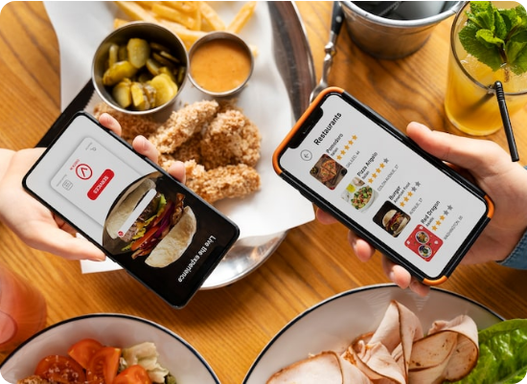
Digital Transformation in Turbat
360 Café and Outlets is a strategic digital initiative engineered to modernize the Citizens of Turbat.
By replacing archaic manual ordering with a unified platform, the system bridges the operational gap between hungry customers and busy small business vendors.
Leveraging a Microservices Architecture, the platform offers a seamless, cashless, and highly efficient ordering experience.

Slide 4






The "Rush Hour" Bottleneck
Manual Queuing
Inventory Gaps
Lack of Records
Significant time wasted in lines during peak hours, leading to crowding and stress.
Informal ordering lacks real-time stock sync; customers often order items that are out of stock.
Traditional methods lack financial transparency and data-driven insights for small vendors.

Slide 5
Strategic Core Objectives
Operational Optimization: Distribute order flow digitally to mitigate rush-hour bottlenecks in kitchens.
Financial Transparency: Transition vendors from intuition-based to data-driven decision making via KPI tracking.
Scalable Infrastructure: Architect a city-wide foundation capable of handling hundreds of concurrent users.
User Convenience: Provide Local Citizens with real-time menu browsing and transparent order tracking.

Slide 6
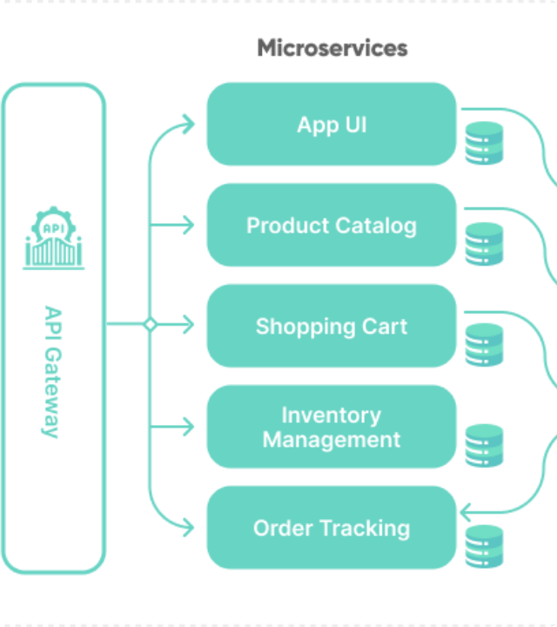
3-Tier Architecture
Presentation Tier: Flutter-based Customer App & Shop Owner Dashboard.
Application Tier: Node.js Microservices (Auth, Shop, Product, Order) managed via API Gateway.
Data Tier: PostgreSQL for transactional reliability and Cloudinary for optimized media delivery.

Slide 7
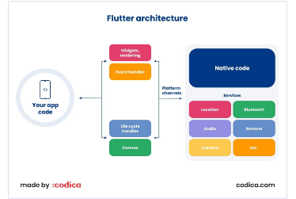

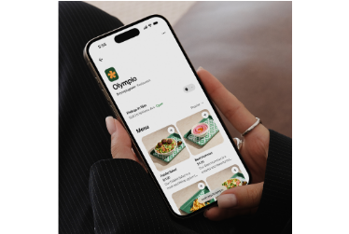
Modern Technology Stack
Flutter 3.x
Node.js & Postgres
Socket.io
Cross-platform UI development for Android/iOS with Provider state management.
Event-driven runtime with ACID-compliant relational database for data integrity.
Persistent bi-directional WebSocket communication for instant order alerts.

Slide 8
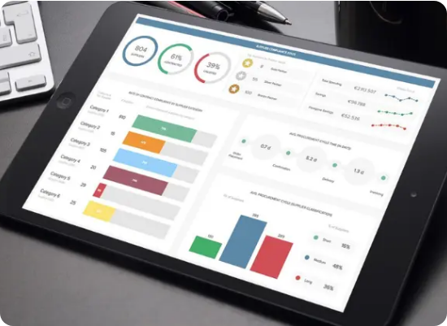
The Unified Ecosystem
Customer Mobility
Google Sign-In, Smart Discovery, Persistent Cart, and Real-time Tracking ensure a frictionless "Order-to-Fulfillment" journey.
Vendor Command Center
Live Kitchen Feed, Master Shop Toggle, and Dynamic Menu Engineering empower non-technical shop owners.

Slide 9
System Performance & Impact
Efficiency Benchmarks
40%
Optimized API payloads (JSON) and Cloudinary media transformations ensure the app loads in under 2 seconds even on 3G networks.
Docker containerization allows for sub-minute disaster recovery and seamless horizontal scaling.
Average Wait Time Reduction

Slide 10
Problem Solving & Resilience
Real-Time Sync
Digital Literacy
Challenge: Immediate order visibility without refreshing.
Solution: Implemented Socket.io with a "Hybrid Sync" mechanism to handle intermittent internet drops.
Challenge: Intimidating complex dashboards for vendors.
Solution: Relentless UI simplification, using large color-coded action buttons and intuitive linear flows.

Slide 11
Questions & Discussion
v2.0 Roadmap: Integrated E-Wallets, AI Personalization, and Rider Delivery Network.
Adnan Imam | Baloch Khan | Fahad Rahim
University of Turbat - January 2026

